Slide 1


Slide 2

What is Power BI
Power BI is a Business Analytics Service Provided by Microsoft That Lets You Visualize Your Data and Share Insight.

Slide 3

Why Power BI
Power BI Allows You To View Analyze & Visualize Huge Quantities of Data That Cannot be Opened in Excel.
It has easy Drag & Drop Functionality.
Using Power BI With Azure allows you to Analyze and Share large Volumes of Data.

Slide 4
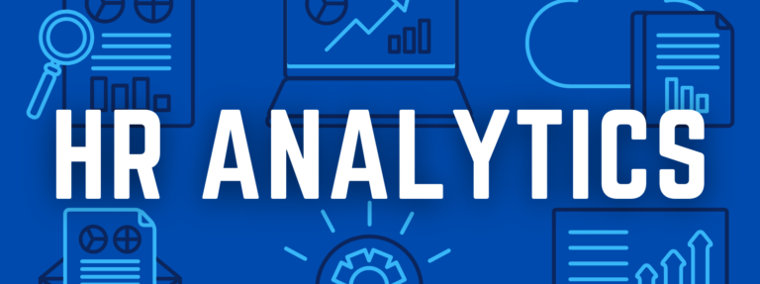
HR Analytics (also known as people analytics) is the collection & application of talent data to improve critical talent and business outcomes.

Slide 5

Project Description
In this dashboard we have learned how to create card visuals with Logo, Donut chart visuals, Bar and Clustered Column chart, Matrix(Table) Visual and Heat Map along with different slicer's and it's formatting.

Slide 6
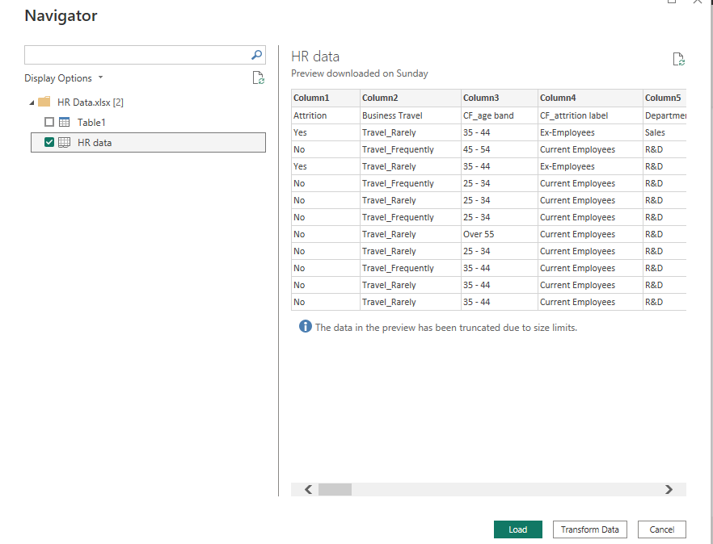
Dataset & Data Exploration
Rows-1470 Column-44

Slide 7
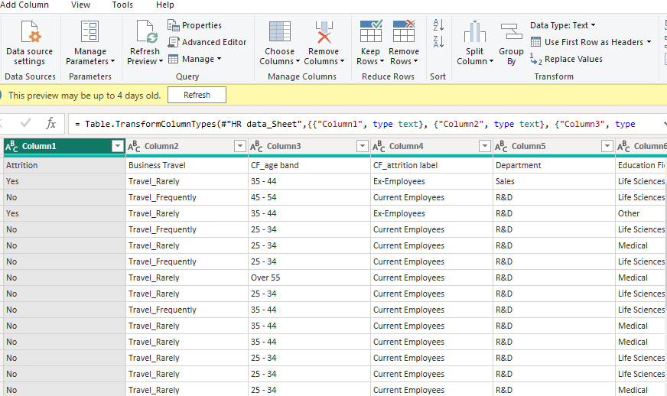
Data Cleaning & Manipulation

Slide 8
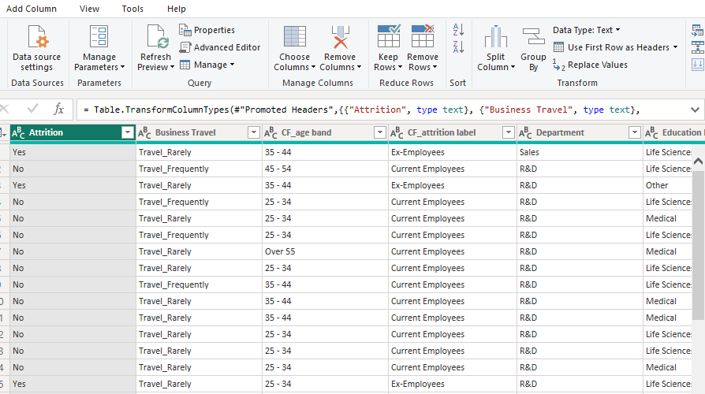

Slide 9
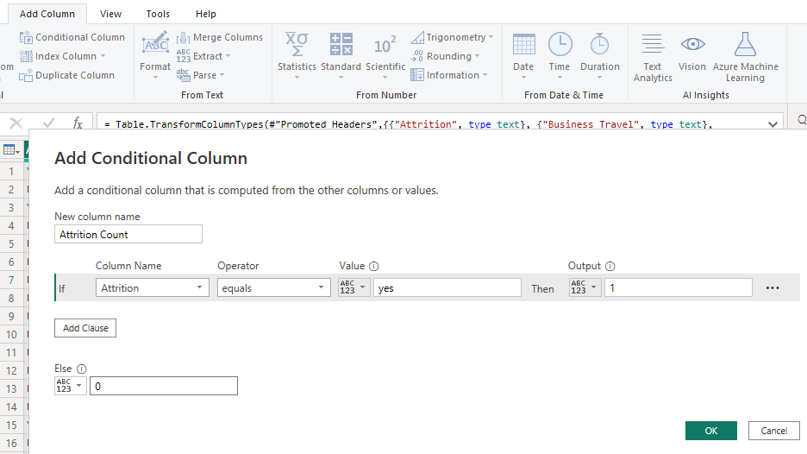
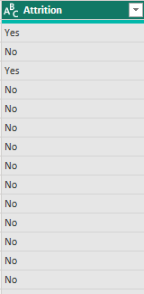

Slide 10
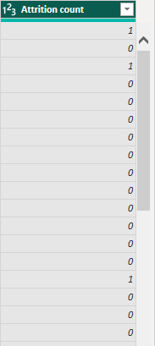
BEFORE
AFTER

Slide 11
Data Modelling
Measures for Attrition Rate
Measures for Active Employee's

Slide 12
Data Visualization
For these I use Card Visual. A Card is useful to display a single number (or metric value)

Slide 13
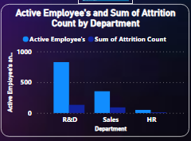
For these visual I used Clustered Column Chart. The Clustered column chart is useful to display the comparison of multiple series as in the vertical axis. Here we select multiple series like Active Employee's and Sum of Attrition Count.

Slide 14
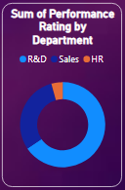
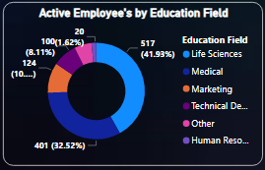
For both these visual I used Donut chart. Donut Chart are best used to compare a particular section to the whole, rather than comparing individual section with each other
A donut chart shows the relationship of part to a whole. But a donut chart can contain more than one data series each data series that you plot in a donut chart adds a ring to the chart.

Slide 15
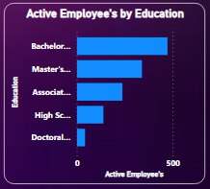
For these I used Clustered Bar Chart. Power BI Clustered Bar Chart display values (i.e measures) where the length of the bar or column is proportional to the data.
Clustered Bar charts are means to display a measure against a single dimension. A second dimension can break the primary dimension further more.

Slide 16
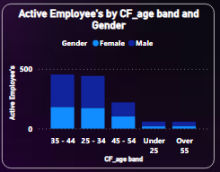
Stracked Column Chart is form of bar chart that shows the composition & comparison of a few variables, either relative or absolute, over time.

Slide 17
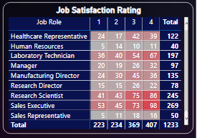
Matrix automatically aggregates the data & enables you to drill down. You can create matrix visuals in Power BI reports & cross-Highlight elements within the matrix with other visuals on that report page

Slide 18
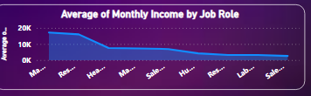
Area Chart is a graph that combines a line chart and a bar chart to show changes in quantities over time.

Slide 19

Slicers are a kind of filter. Place a slicer on a sheet to filter all of the visualizations on the sheet at once. When you click an item in the slicer, all of the visualizations with related content are filtered by the item you select.

Slide 20
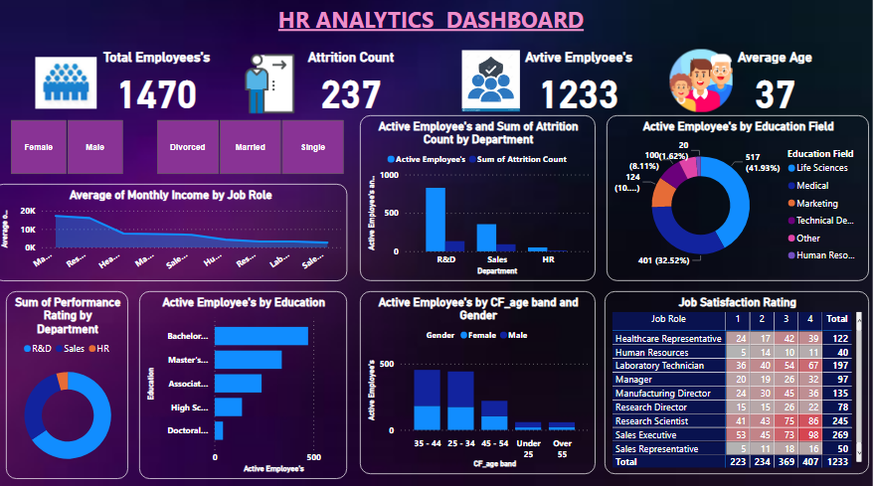
Report / Dashboard
R

Slide 21

Conclusion
Ultimately, Power BI is able to drive better decision-making in business through its ability to provide insights in visually impressive and interactive reports.

Slide 22

Shilpa Poojari

